Slide 1

Cambridge Analytica - how do we stop it happening again?

Slide 2
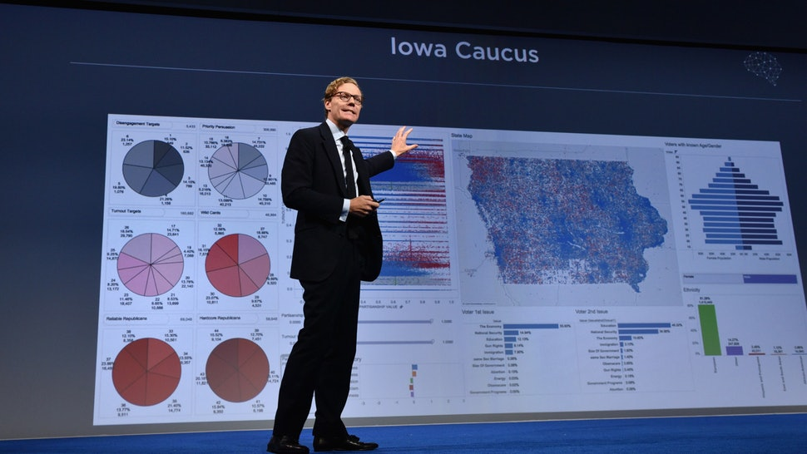

Slide 3
The Cambridge Analytica scandal which erupted in March 2018 brought to light the potential of personal data being utilised without consent for political advertising purposes. It brought into question the results of both the US Presidential Elections and the Brexit vote in the UK.
We’d like you to consider not only how we can ensure something similar to Cambridge Analytica doesn’t happen again, but also how can we ensure that elections in general remain free of interference.

Slide 4
2.2 Presentation
Presentations will be held on Monday morning. You will have 15 minutes for the presentation and 5 minutes for questions.
We expect you to:
Summarise the topic you are discussing
Identify the challenges and ambiguities
Highlight some potential solutions or approaches to addressing the challenges
Conclude with your personal opinion or recommendation
We suggest you:
Focus on getting your points across clearly and succintly
Do not go over the time limit
Use visuals to bring the topic to life

Slide 6
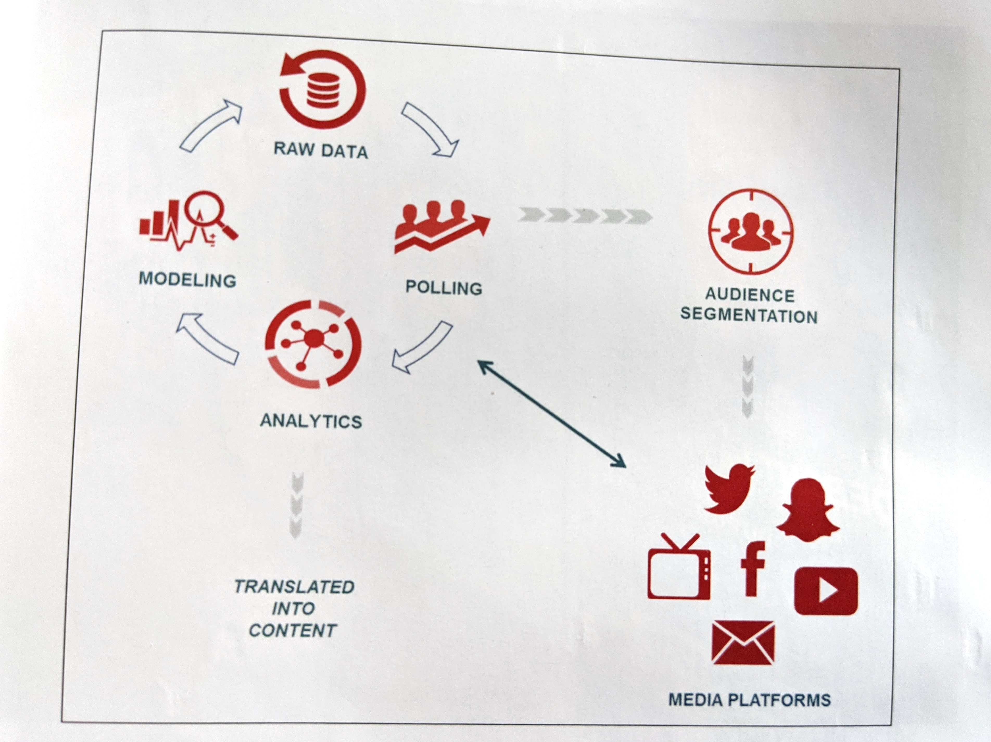
How psychographic information is collected
A public presentation to the Concordia Annual Summit in September 2016 by Cambridge Analytica’s then-CEO Alexander Nix gave the world one of its first glimpses into the psychographic techniques used by the company.
Traditional focus groups/interviews
Set-top box viewing data
Surveys/questionnaires/quizzes
Psycholinguistic dictionaries
Website analytics (e.g. Google analytics)
Browsing Data
Social media (i.e. likes, clicks, tweets, posts, etc.)
Third-party analytics

Slide 7
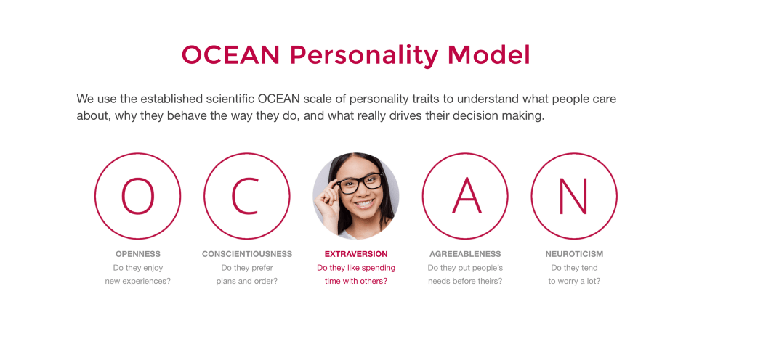

Slide 8
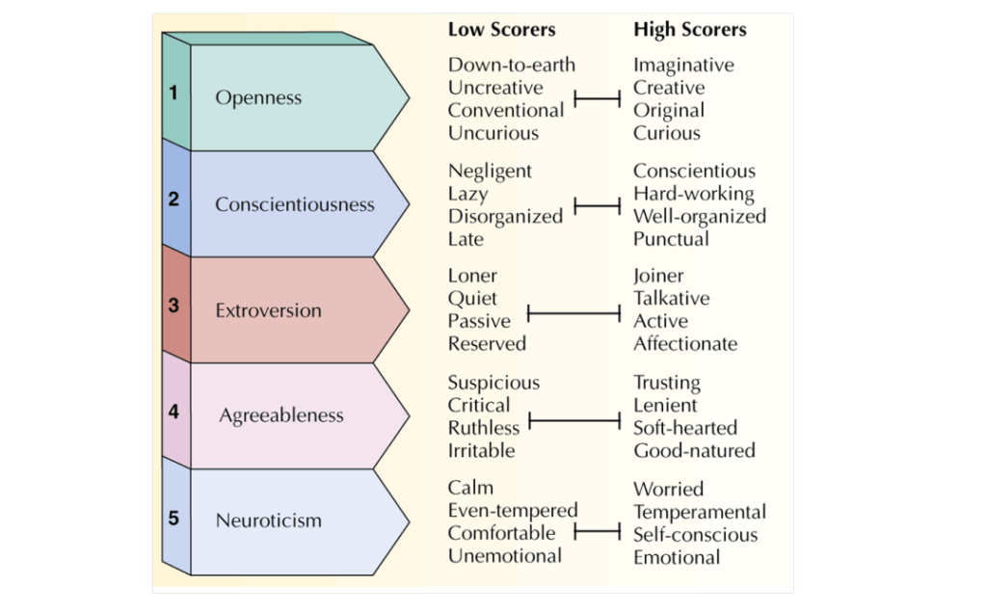

Slide 9
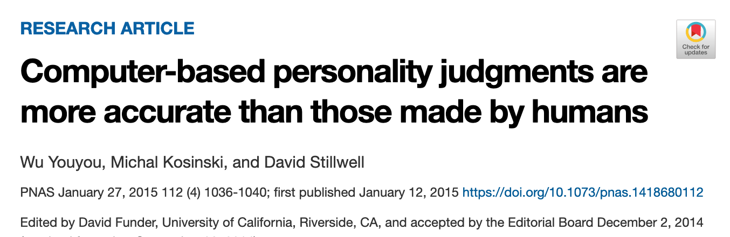
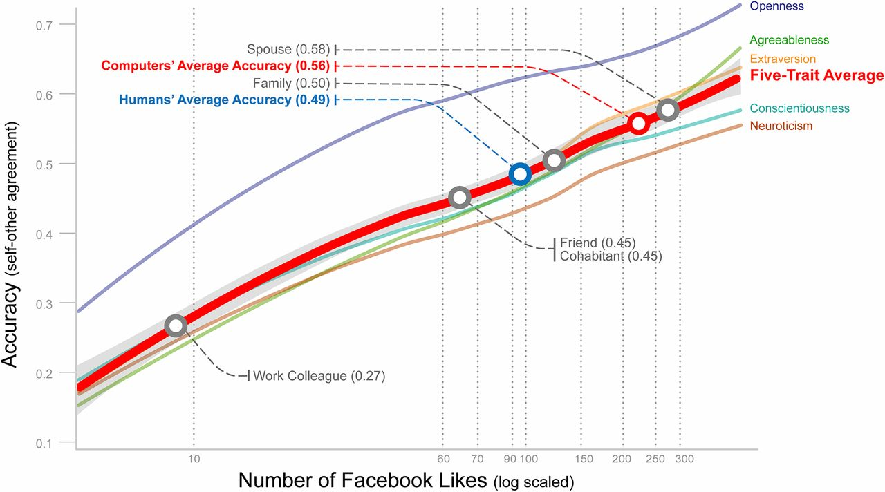

Slide 10
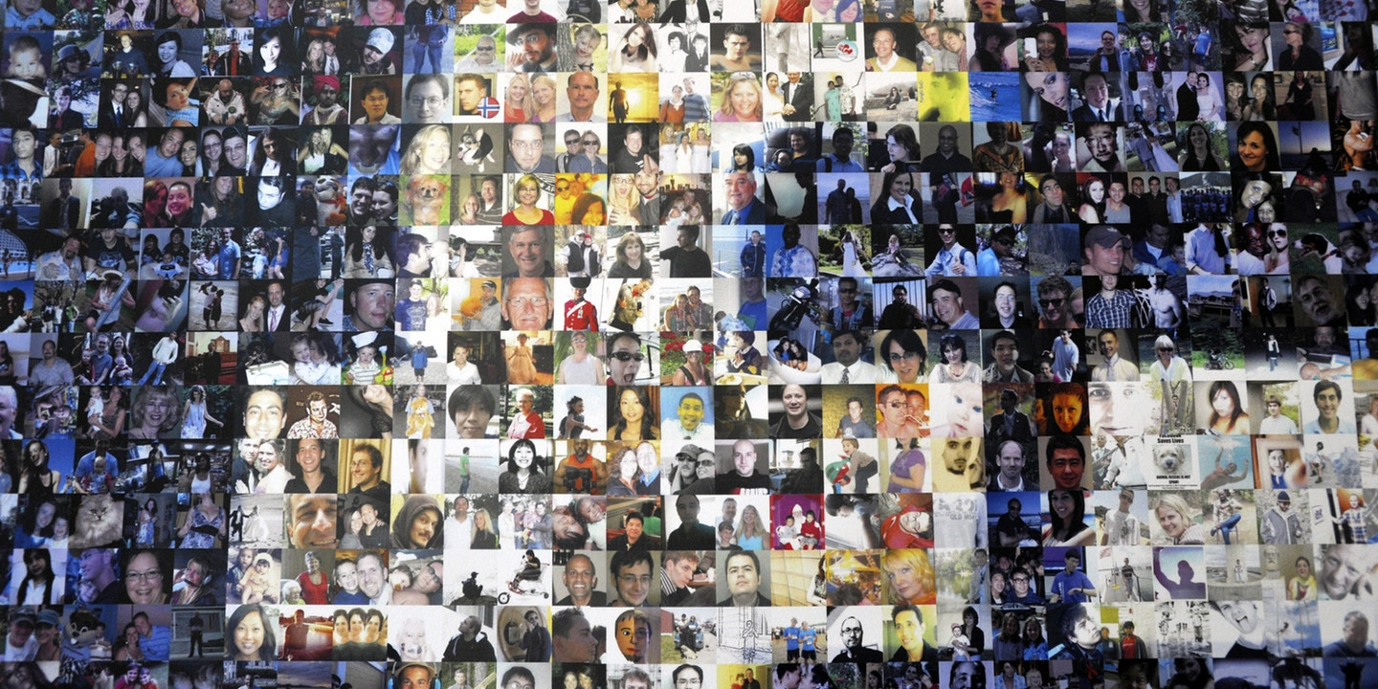
CA collected 220 million US citizens data with 5,000 separate data points for each of them
Considered the largest database ever built in behavioral data and psychometric modelling
Created under the basis of creating a novel research area denominated Computational psychology
Data collected from Facebook Graph API among others
On July 22nd, 2019, the Federal Trade Commission presented a case against CA, which hearings will be held on March 24th, 2020

Slide 11
Here's her photo, here's where she works, here's her house. Here are her kids, this is where they go to school, this is the car she drives.
She voted Romney in 2012, she loves Katy Perry, she drives an Audi, she's a basic ... and on and on and on.
We knew everything about her for many records, the information was updated in real time, so if she posted to Facebook, we could see it happening.
And not only did we have all her Facebook data, but we were merging it with all the commercial and state bureau data we'd bought as well. And imputations made from the US Census.
We had data about her mortgage applications, we knew how much money she made, whether she owned a gun. We had information from her airline mileage programs, so we knew how often she flew. We could see if she was married (she wasn't). We had a sense of her physical health.
And we had a satellite photo of her house, easily obtained from Google Earth. We had re-created her life in our computer. She had no idea.

Slide 12
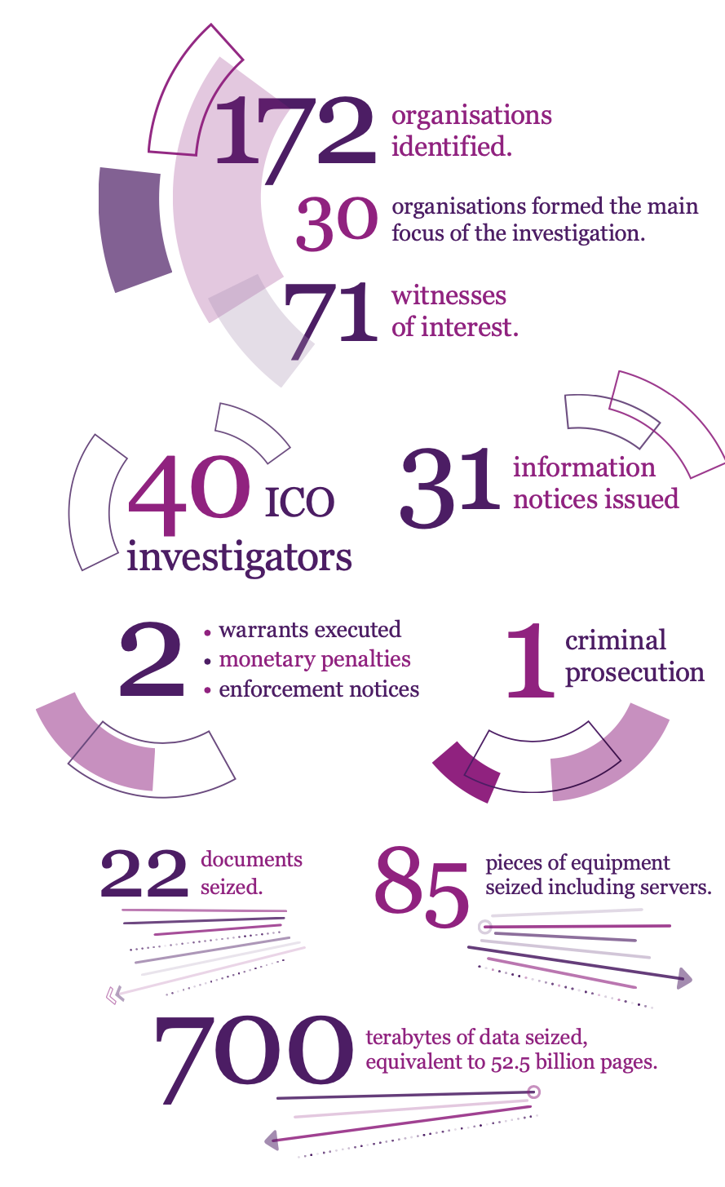
Information Commissioner’s Office Investigation into the use of data analytics in political campaigns A report to Parliament 6 November 2018
We sent 11 warning letters requiring action by the main political parties
Fined Leave.EU and Eldon Insurance (trading as GoSkippy) £60,000 each.
Fined Leave.EU £15,000 for a separate, serious breach of PECR regulation 22 after almost 300,000 emails were sent to Eldon Insurance.
We issued Facebook with the maximum monetary penalty of £500,000
We issued a monetary penalty in the sum of £140,000 to data broker Emma’s Diary (Lifecycle Marketing (Mother and Baby) Limited
We are in the process of referring CA to the Insolvency Service.
We issued an Enforcement Notice to AggregateIQ to stop processing retained UK citizen data.

Slide 13
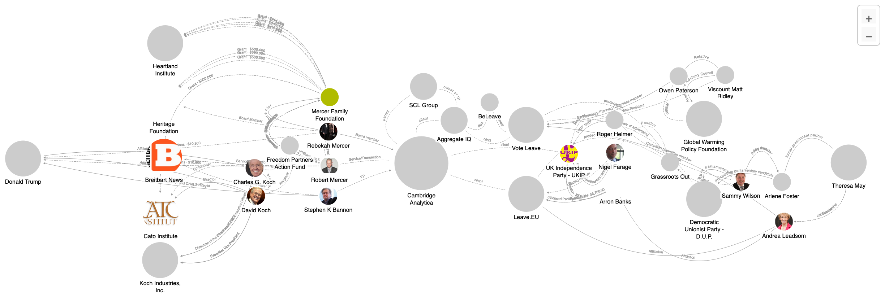
Cambridge Analytica network analysis
https://littlesis.org/maps/2897-cambridge-analytica-brexit-trump-and-climate-science-denial

Slide 14
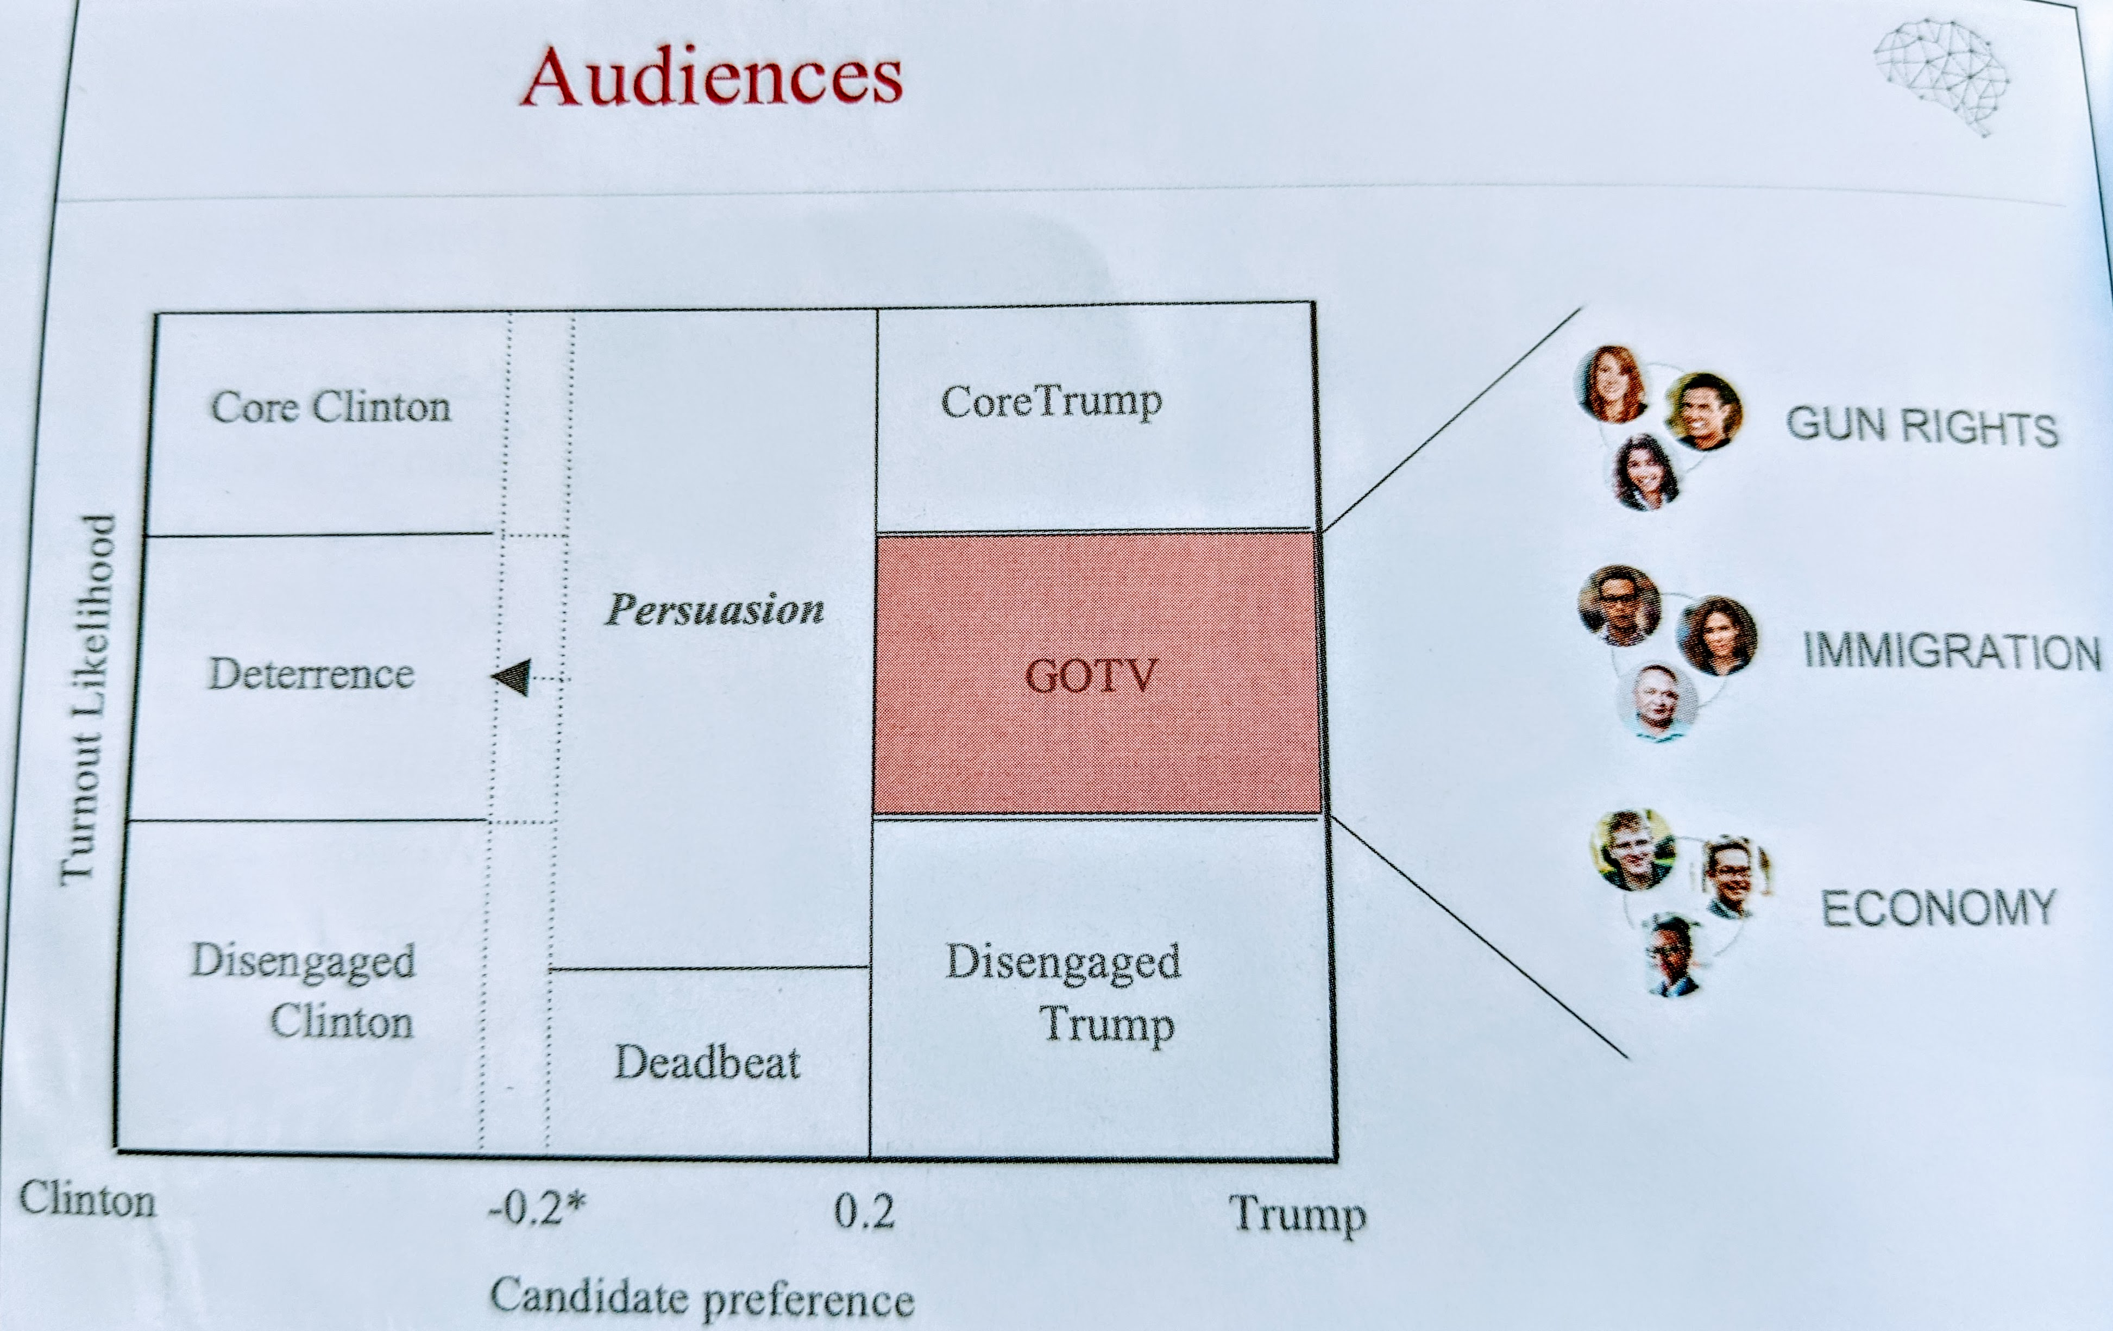
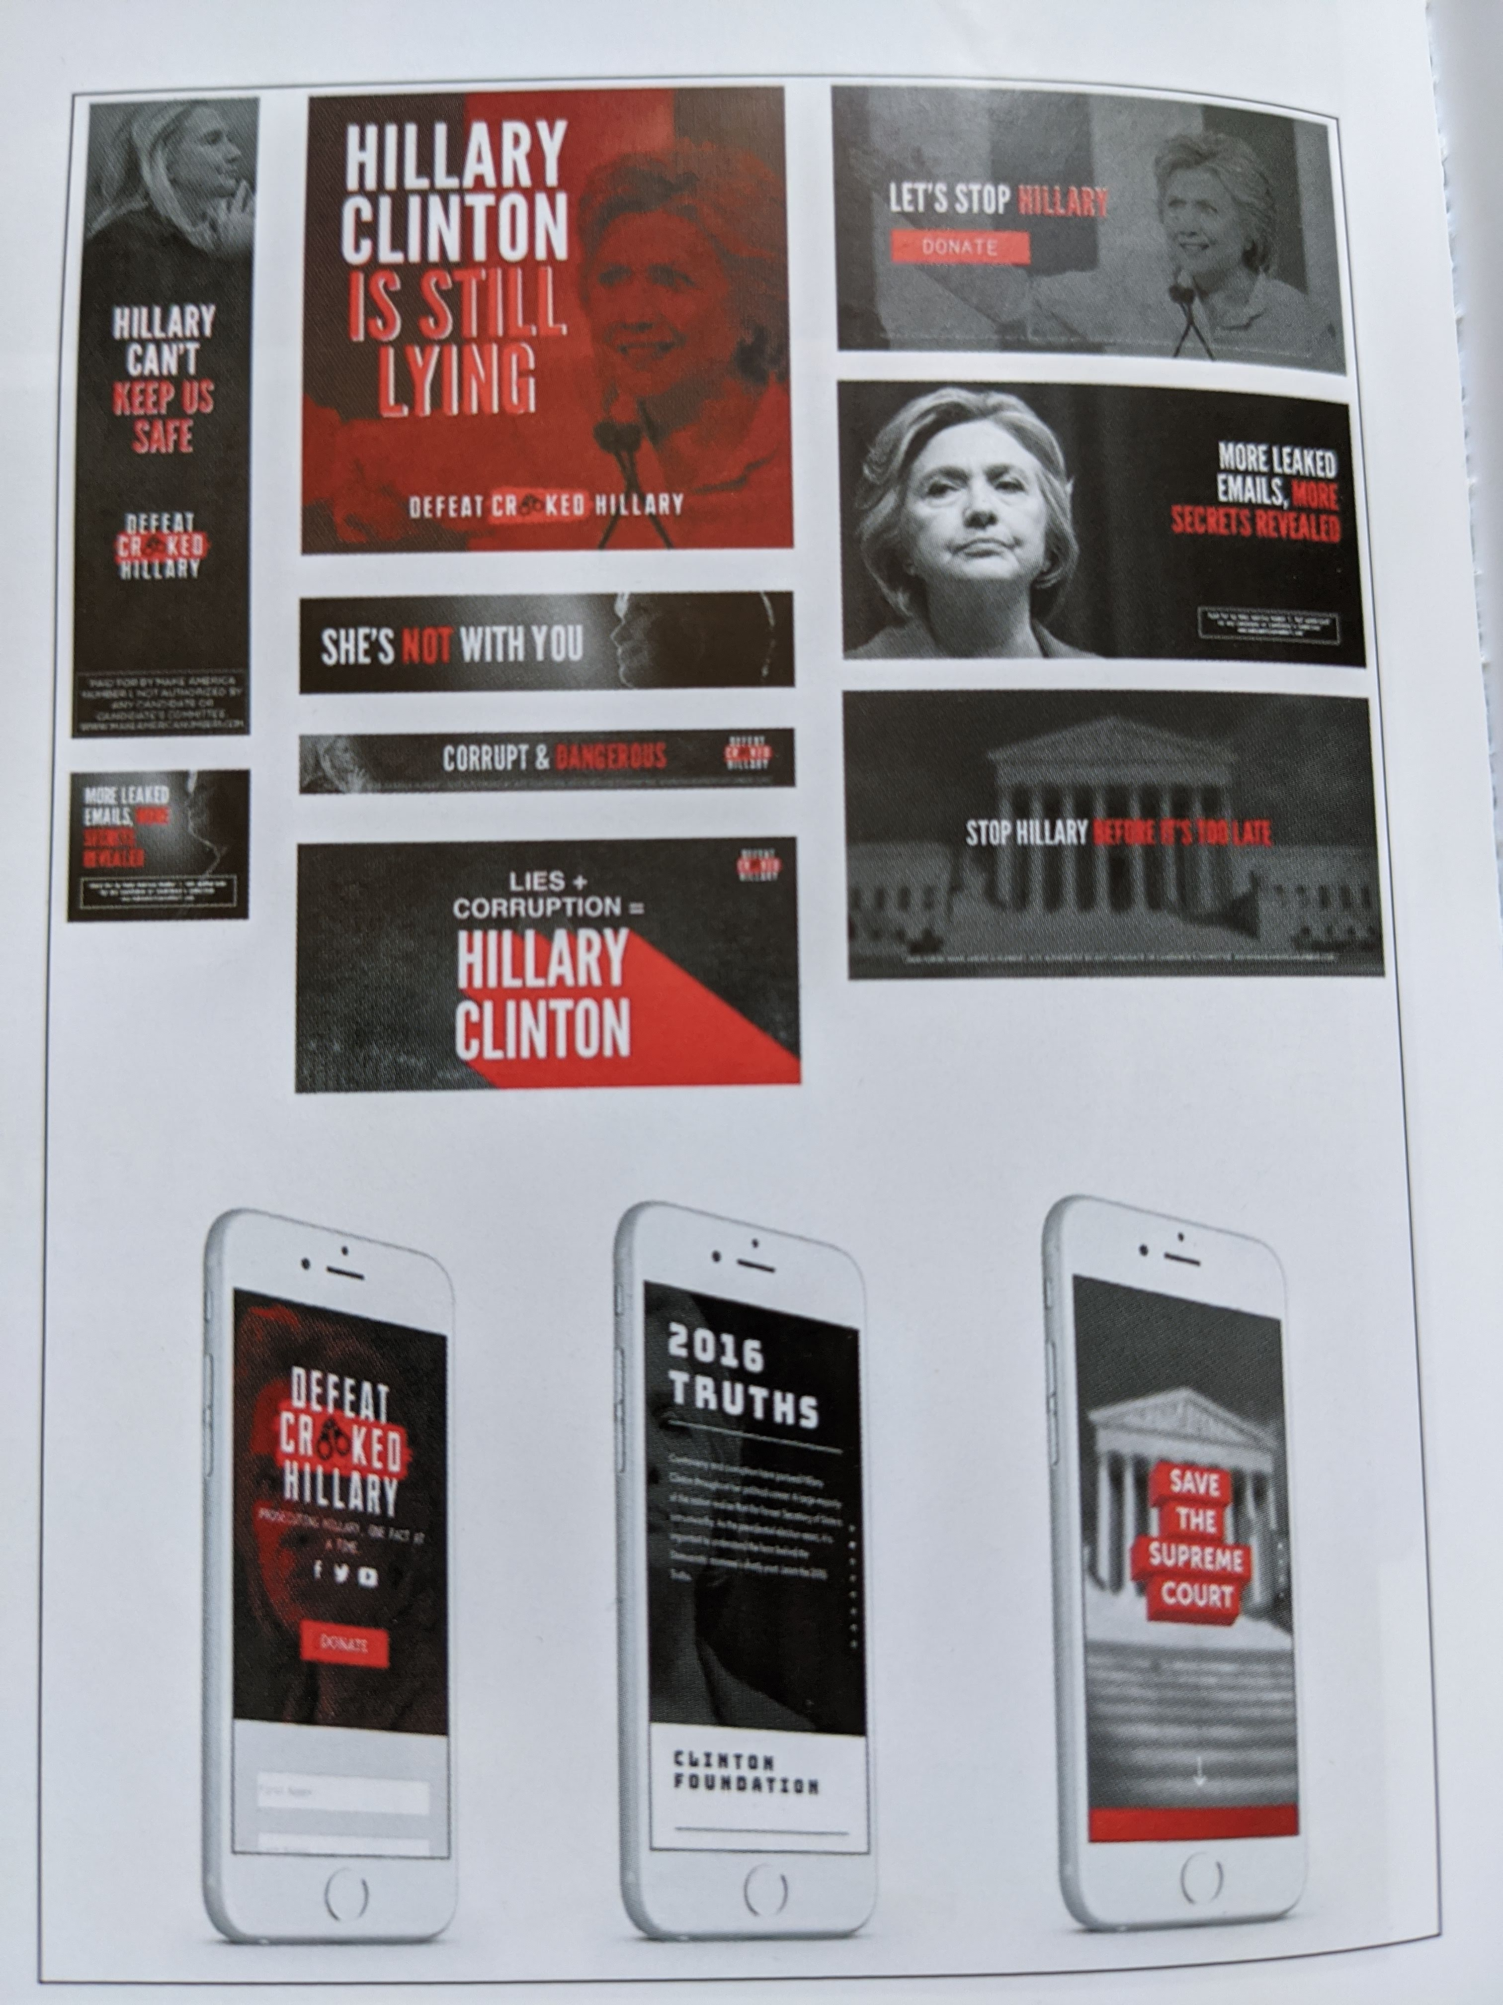

Slide 15
Recommendations for a Data society
A building code for the Internet
A code of ethics for Software Engineers
Internet utilities and the Public interest
Public stewardship of the Digital Commons

Slide 16
Emerdata Limited Company number 10911848
Emerdata's board of directors included Frontier Services Group officer Johnson Chun Shun Ko. Cambridge Analytica investor Rebekah Mercer, and Cambridge Analytica CEO Alexander Nix
In July 2019, it was revealed that Emerdata Limited "fully acquired" the SCL companies including SCL, Cambridge Analytica and Aggregate IQ.

